Slide 1

Using AI as a Tool to Assist Students in an Engaged Learning Course
Ning Yang
ISSCM
Quinlan School of Business

Slide 2



Background of the course
ISSCM 393 Requirements Analysis and Communication
Project-based course
Students develop a requirements analysis for real projects for real clients
For the students, the clients are their “boss”
Constraints: budget, time

Slide 3

Problem encountered
Required course
Senioritis
Searching for jobs
Lack of intrinsic motivation:
Cannot choose their clients/projects
Not comfortable taking on projects outside their majors

Slide 4

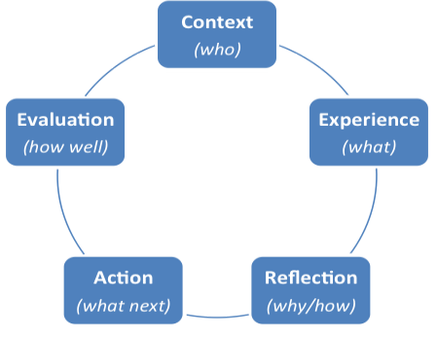
The Ignatian Pedagogical Paradigm
Notes:
Context: What needs to be known about learners (their environment, background, community, and potential) and the subject matter to teach well?
Experience: How do you engage learners as whole persons in the learning process? the lived experience of each individual in the learning space must be invited and embraced in a Jesuit education. We acknowledge that each person’s background and learning thus far in their lives has direct implications for their learning going forward.
Reflection: How may learners become more reflective so they more deeply understand what they have learned? How does what they are learning dialogue with their deeply held values?
Action: How do we compel learners to move beyond knowledge to action?

Slide 5
Introducing AI to students
Client meetings: communications
Goals of the projects: what is the business problem?
How to achieve the goals within three months?
Using AI to assist them in how to solve a business problem
Notes:
You do not want to bring this powerful tool out too soon.
24/7, no judgement, personalized

Slide 6
Examples from the course
How to promote small business online?
How to promote small business using social media?
How to make attractive TikTok videos?
How to promote your podcast?
What makes a good digital learning platform?
Notes:
It is very good tool to provide very general and summarized knowledge. The good thing is that you can keep on asking. prompting
Love the bulletin points style

Slide 7
What to expect from students using AI
Remove some obstacles for them
01
Focus on research and actions
02
Less worry about the grades
03
Learn how to use AI to assist them in conducting a project
04
Notes:
I would use the results from AI as a baseline and explicitly tell my students that they need to outperform it.
I teach them how to do research.
Search, “re”search. The important difference between AI generated information and research is that students actually go to the source and read the material and quote them.

Slide 8
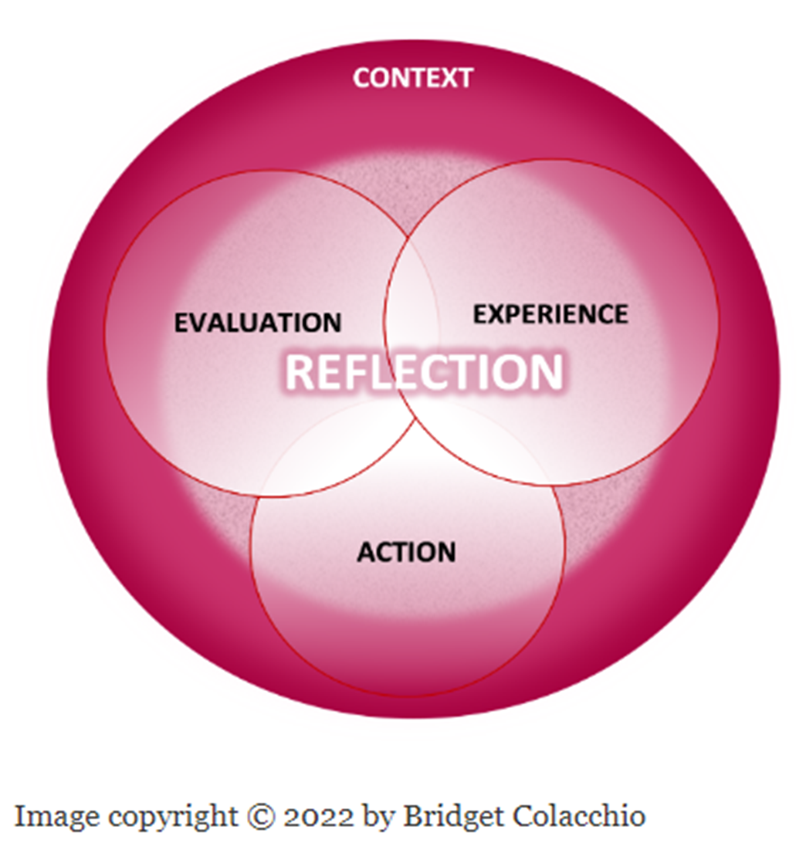
Reflections
Notes:
Taken together, these processes of taking action based on what we have learned while evaluating the effect of our experience and action on ourselves and those around us are in continual interaction with one another, demonstrated by the overlapping circles. The glue that forms and informs those connections is the practice of reflection
With consistent, intentional and often guided opportunities for reflection on - and discernment of - our learning, our relationships, our actions and context, we can deepen our learning and discover ever more occasions to lead truly extraordinary lives.

Slide 9

Thank you!!
Q and A

